Slide 1


SMART INDIA HACKATHON 2024
TITLE PAGE
Problem Statement ID –1599
Problem Statement Title - Student innovation
Theme- Fitness & sports
PS Category- Software
Team ID- Team 54
Team Name- TEAM AURA

Slide 2
IDEA TITLE
TEAM AURA
A web application platform that Empowers users with fitness through AI-based technology
Objective: A platform that offers personalized workout plans and diet plans with progress tracking tools all integrated in one platform.
Web will facilitate:
1. Provide
Real-time progress tracking
Uniqueness: Integrity of various AI based features in a single web application.

Slide 3
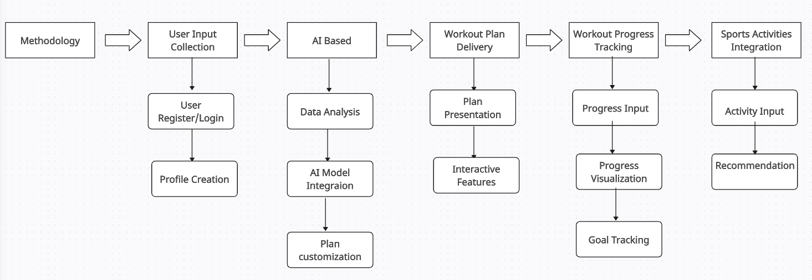
TECHNICAL APPROACH
TEAM AURA
Programming Language used:
Frontend : HTML, CSS, React JS
Backend and AI integration : Python , Gemini AI(API)
Data Base : MySQL , firebase
Methodology:

Slide 4
FEASIBILITY AND VIABILITY
TEAM AURA
Feasibility:
Integration of AI for personalized fitness is feasible, to analyze user data and provide tailored recommendations
Potential challenges:
Lack of Knowledge & Intimidation
Consistency & Motivation 3. User engagement
Strategies for overcoming these challenges:
Provides a transparent roadmap with updates and continuous improvements
Maintain a support system that addresses user concerns promptly and transparently.

Slide 5
IMPACT AND BENEFITS
TEAM AURA
Impact : This Web app enhances user outcomes with personalized workout and nutrition plans, including for those with medical conditions or disabilities, through real-time feedback, virtual tutorials, and comprehensive tracking.
Benefits of the solution :
Personalized Guidance : Customizes workout and nutrition plans for all users, including beginners, medical patients, and those with disabilities.
Enhanced Engagement : Offers real-time feedback and virtual tutorials to keep users motivated.
Comprehensive Tracking : Provides detailed progress and nutrition tracking for effective health management.
User-Friendly : Features an intuitive interface that simplifies navigation for beginners.
Inclusivity : Ensures accessibility for a diverse range of users, promoting overall well-being.

Slide 6
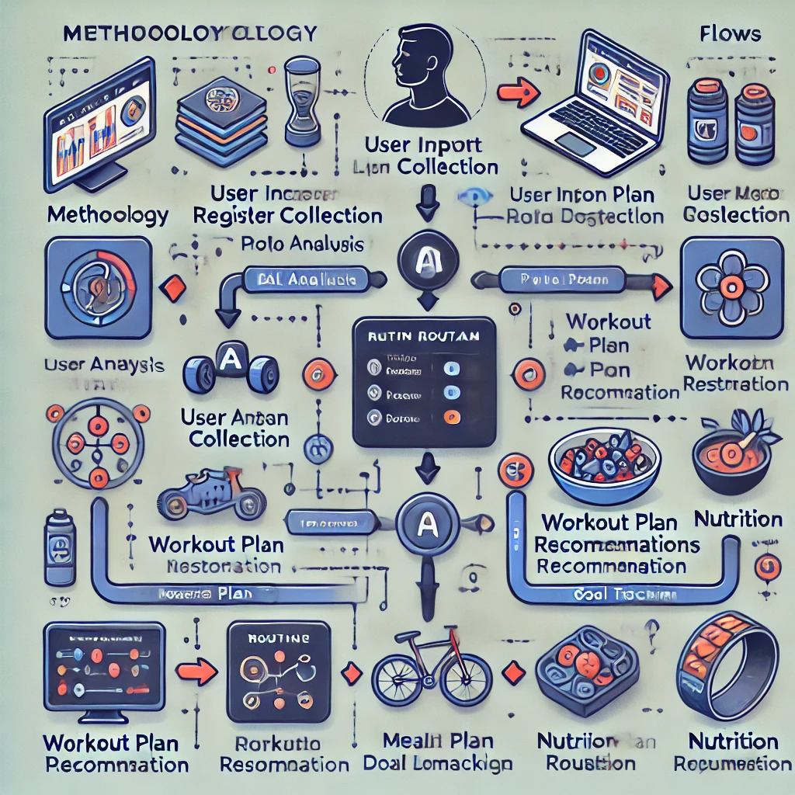
RESEARCH AND REFERENCES
TEAM AURA
Other fitness apps usually provide generalized plans and do not consider the needs of medical patients or individuals with disabilities, lacking tailored adaptations and comprehensive tracking.
Our solution offers specialized, customized workout and nutrition plans tailored for medical conditions and disabilities, providing detailed real-time feedback and comprehensive tracking to address individual health needs effectively.

